Slide 1


Slide 2

Developer
Code Yourself Out of a Job
(and into your admin’s heart)
John Schultz, Salesforce

Slide 3

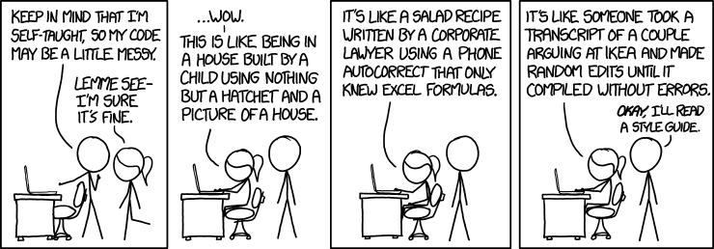
“Code yourself out of a job”???

Slide 4


Slide 5
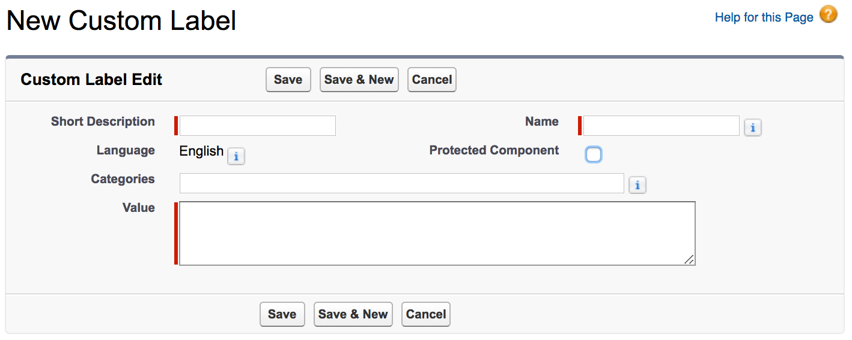
Custom Labels
No hard coded text in your components!
Easy (for an admin) to update
Translatable
Works now with namespaced code in lightning components

Slide 6
Custom Labels : Tips
Use easy to find Short Description and Categories values
Output labels with <lightning:formattedRichText>
Instead of:
<div>{!$Label.c.myGreeting}</div>
Use:
<lightning:formattedRichText value="{!$Label.c.myGreeting}" />

Slide 7
Custom Labels : Tips
Use String.format() in your apex controller for complicated labels
Example: Good morning, John! You have 10 open cases.
Label value: Good morning {0}! You have {1} open cases.
String greeting = String.format(
Label.ContactCardGreeting,
new List<String>{
myContact.FirstName,
myContact.Open_Cases__c
}
);

Slide 8
Custom Settings/Metadata Types
No hard coded IDs!
No hard coded values for logical decisions
Ex: if a field is greater than x
Ex: if a user has more than n opportunities
Ex: send an email to/from this email address…
Ex: record type developer name
Easy for an admin to update
No need to update unit tests

Slide 9



Slide 10
Custom Settings/Metadata Types (again)
For SOQL queries
Ex: …WHERE RecordTypeId = :myCustomSetting__c.RTid__c
Ex: …WHERE Profit__c > :myCustomSetting__c.Goal__c
Easy for an admin to update
No need to update unit tests

Slide 11
Custom Settings/Metadata Types (again)
For trigger management
Toggle triggers on/off for:
Data loading
Unit test data
No need to deploy code to production just to deactivate and then reactivate triggers

Slide 12
Custom Settings/Metadata Types (again)
trigger ContactTrigger on Contact (after insert, ...) {
if (!MyCustomSetting__c.getInstance().Active_Triggers__c) {
return;
}
// do trigger things here...
}

Slide 13
TDTM (Table Driven Trigger Management)
Used by NPSP from salesforce.org
Triggers are controlled through custom object records
Admin can control order, parameters, context, and activation

Slide 14
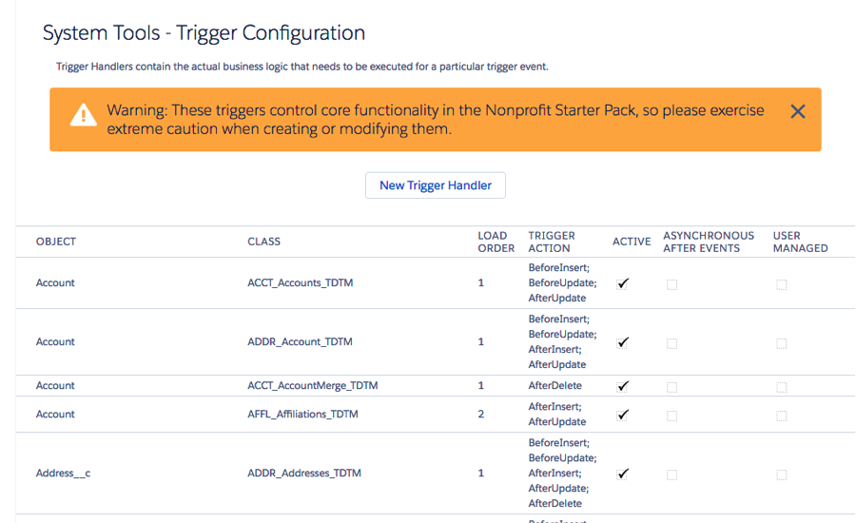
TDTM (Table Driven Trigger Management)

Slide 15
Formula Fields
In apex for logical decisions
In SOQL to get beyond platform limitation
This won't work: …WHERE Resale__c < Our_Cost__c
This will: …WHERE We_Lost_Money__c = true
Pro: easy for admin to update
Con: not so easy to create predictable test data

Slide 16
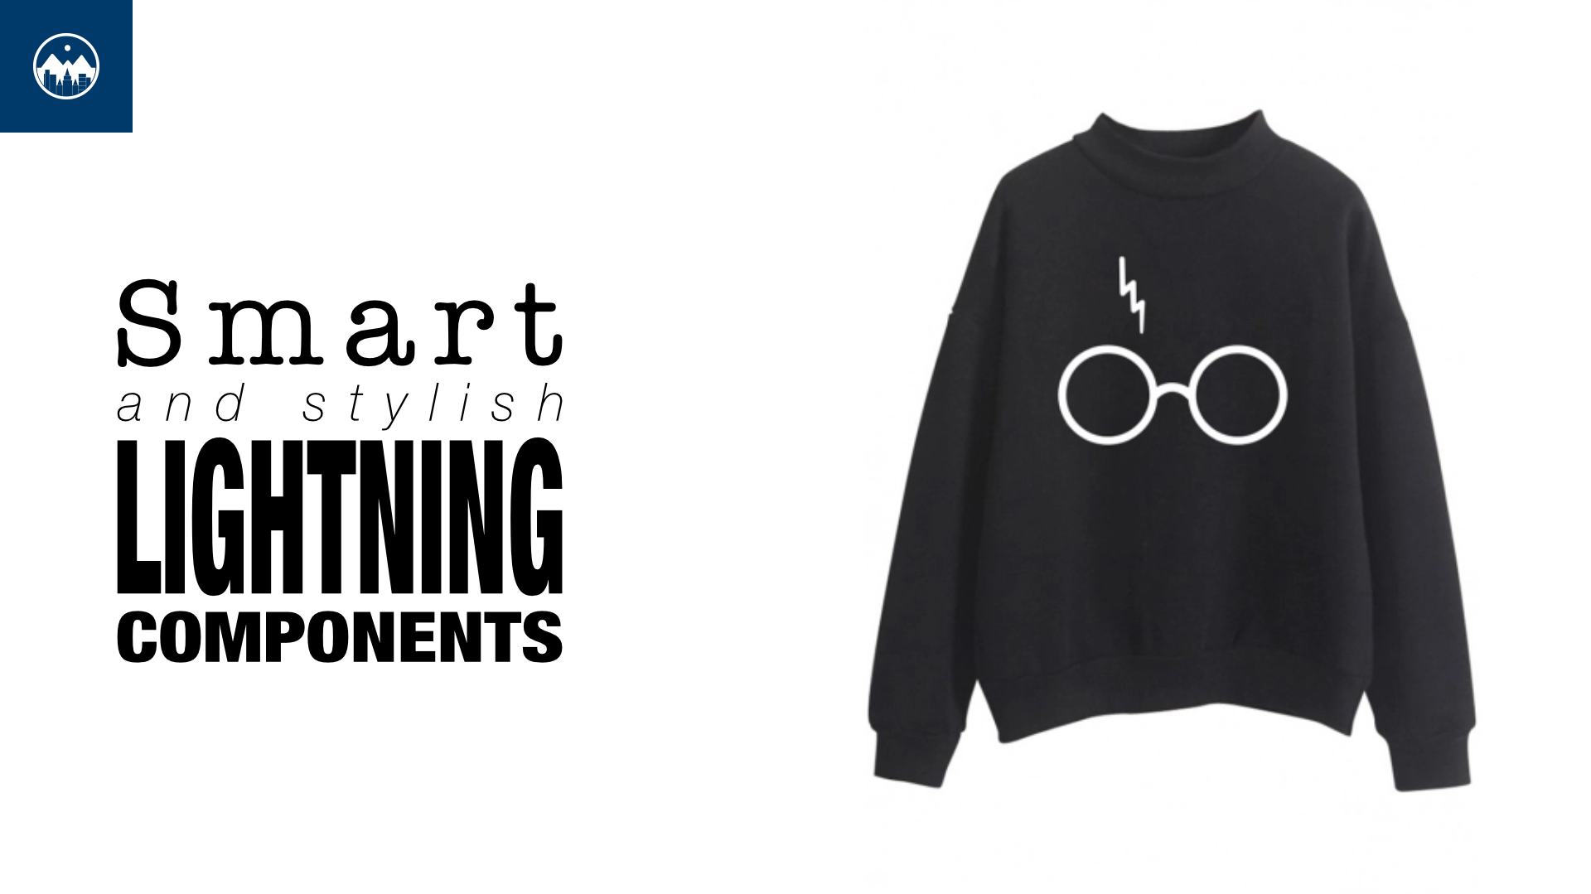

Slide 17
Smart Lightning Components
Self-reliant
Only needs the record ID
Includes recordId attribute for flexibility
<aura:component implements="force:hasRecordId,..." >
<aura:attribute name="recordId" type="Id" access="public" />
...
</aura:component>

Slide 18
Smart Lightning Components
Used for multiple sObject types
public with sharing class MyController {
@AuraEnabled
public static MyViewModel getData(Id recordId) {
String recordSobjectType = recordId.getSObjectType();
if (recordSobjectType == 'Account') {
...
}
else if (recordSobjectType == 'Contact') {
...
}
}
}

Slide 19
Smart Lightning Components
Use apex view model instead of sObject
public class MyViewModel {
@AuraEnabled public String name;
@AuraEnabled public String phone;
public MyViewModel(Contact c) {
this.name = c.Name;
this.phone = c.Phone;
}
public MyViewModel(MyCustomObject__c mco) {
this.name = mco.First__c + ' ' + mco.Last__c;
this.phone = mco.Telephone__c;
}
}

Slide 20
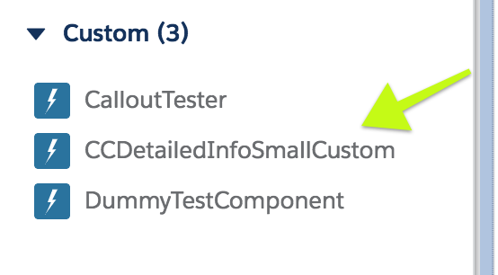
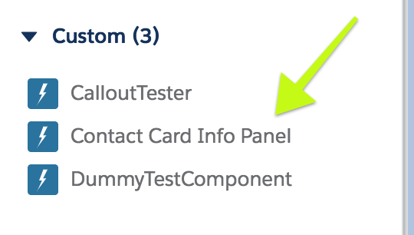
Lightning Design Resource
Add a label attribute to provide user friendly component naming
<design:component label="Contact Card Info Panel">
...
</design:component>

Slide 21
Lightning Design Resource
Limit availability based on sObject type with <sfdc:objects>
<design:component label="Contact Card Info Panel">
<sfdc:objects>
<sfdc:object>Contact</sfdc:object>
<sfdc:object>Lead</sfdc:object>
<sfdc:object>My_Custom_Object__c</sfdc:object>
</sfdc:objects>
</design:component>

Slide 22
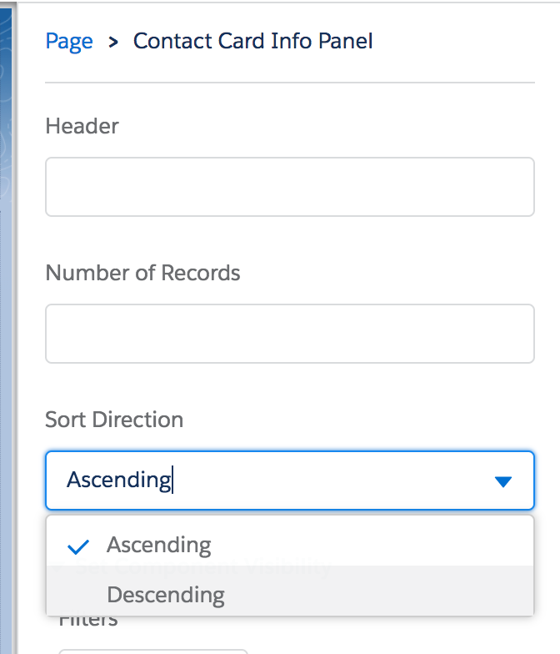
Lightning Design Resource
Allow for configurable design attributes
Ex: number of records to show
Ex: sorting direction
Ex: custom headings/labels
<design:attribute name="header" label="Header" />
<design:attribute name="numberOfRecords"
label="Number of Records" />
<design:attribute name="sortDirection"
label="Sort Direction"
datasource="Ascending,Descending"
default="Ascending" />

Slide 23

Lightning Design Resource
VisualEditor.DynamicPicklist
Attribute options from your apex controller
You can provide options through logic
Or whatever source you want
Even custom labels and settings!

Slide 24
Lightning Component Error Handling
Use try-catch block and throw custom Aura exception
public with sharing class MyController {
@AuraEnabled
public static MyViewModel getData(Id recordId) {
String someImportantValue;
try {
someImportantValue = MySetting__c.getInstance().Field__c;
}
catch (Exception e) {
throw new AuraHandledException(
'Your sys admin forgot to configure the app!'
);
}
...
}
}

Slide 25
Lightning Component Error Handling
Handle the error in lightning component
function(response) {
let state = response.getState();
if ('SUCCESS' === state) {
component.set('v.someAttr', response.getReturnValue());
}
else if ('ERROR' === state) {
let errors = response.getError();
let toast = $A.get('e.force:showToast');
toast.setParams({
title : 'Error!',
type : 'error',
message : errors[0].message
});
toast.fire()
}
}

Slide 26
Lightning Component Error Handling
Provide a way to get more details
Expose details of error in the UI
Output to console
User interaction to see error
!
There was an error saving your Event.
Details: Your system administrator has not configured the record types for your
advising events object.

Slide 27
Summary
No hard coded text (custom labels)
No hard coded values (custom settings)
Admin customizable SOQL queries
Admin customizable apex logic
Admin customizable trigger management
Admin friendly lightning components
Admin friendly debugging

